Slide 1
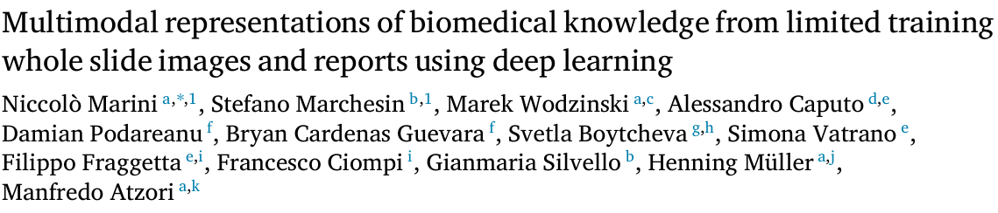

Multimodal Representations of Biomedical Knowledge from Limited Training Whole Slide Images and Reports Using Deep Learning
Name - Prabal Ghosh
Course- Medical Image Analysis
Msc Data Science and Artificial Intelligence (M2)
Université Côte d’Azur, Sophia Antipolis, France
https://doi.org/10.1016/j.media.2024.103303

Slide 2
Introduction
Increasing availability of Importance of combining multiple data modalities (images and reports) for biomedical data
Develop a multimodal architecture to link visual content of images with textual content of reports
This paper presents a deep learning framework that fuses these two modalities to form a unified representation, thereby enhancing classification, retrieval, and interpretability in computational pathology

Slide 3
Related Work
Previous Approaches:
Multiple Instance Learning (MIL):
State-of-the-art framework for weakly-supervised models in computational pathology
Examples: ABMIL, ADMIL, CLAM, TransMIL, DTMIL, MMIL-Transformer
Self-supervised learning (SSL)
Framework to exploit unlabeled data for learning relevant data representation
Examples: MoCO, simCLR, DINO, REMEDIS, HIPT, SRCL, iBOT, Virchow
Vision-language models (VLM):
Algorithms to build data representation combining images and texts
Examples: CLIP, CoCa, ConVIRT,
Multimodal learning in computational pathology:
Combining multiple sources of pathology data
Examples: MI-Zero, PLIP, CONCH
Limitations:
Need for large annotated datasets
Limited generalization capabilities

Slide 4
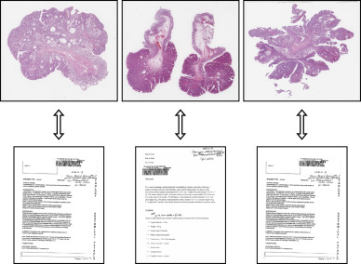
Methodology - Data Processing
Image Data (WSIs):
Split into 224×224 patches at 10× magnification.
Tissue segmentation using HistoQC.
Augmentation: Random rotations, flipping, and color adjustments.
Text Data (Reports):
Translation to English using pre-trained MarianMT neural machine translation models.
WordPiece Tokenization using BERT.
Augmentation: Back-to-back translation, insert/rephrase,
GPT-3 paraphrasing.

Slide 5
Methodology - Network Architecture
Image Branch:
CNN (ResNet34)backbone pre-trained with MoCo v2.
Attention-based Deep Multiple Instance Learning (ADMIL) for patch aggregation.- 128-dimensional embedding that represents the entire slide
Text Branch:
PubMedBERT for domain-specific text encoding.
Projection to 128-dimensional embeddings.
Shared Projection Head:
Aligns image and text embeddings into a common latent space.

Slide 6
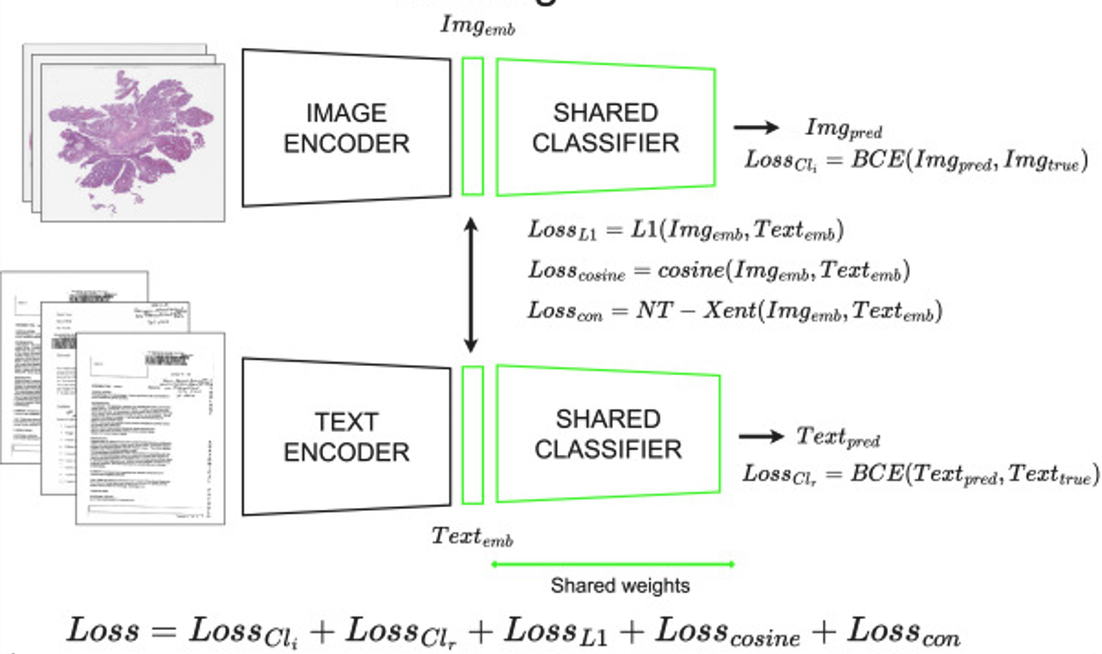
Methodology - Loss Functions
Supervised Loss: Binary cross-entropy for multilabel classification.
Self-Supervised Losses:
NT-Xent (contrastive loss) for paired image-text alignment.
L1-loss for minimizing absolute differences.
Cosine similarity loss for directional alignment.
Total Loss:
Weighted sum of supervised and
self-supervised components.

Slide 7
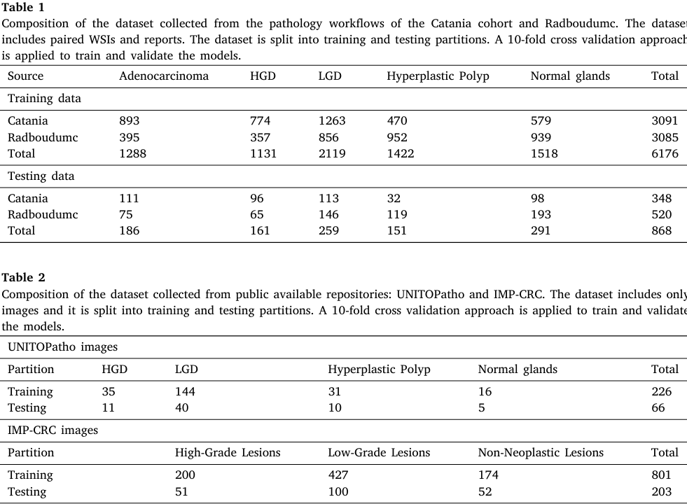
Data Collection

Slide 8
Experimental Setup
Datasets:
Internal: 6176 WSIs + reports (Catania cohort, Radboudumc).
Public: UNITOPatho (4 classes), IMP-CRC (3 classes).
Tasks:
WSI classification.
Multimodal retrieval.
Concept linking for visual ontology creation.
Metrics:
Weighted macro F1-score,
precision@k, mAP,
accuracy.

Slide 9
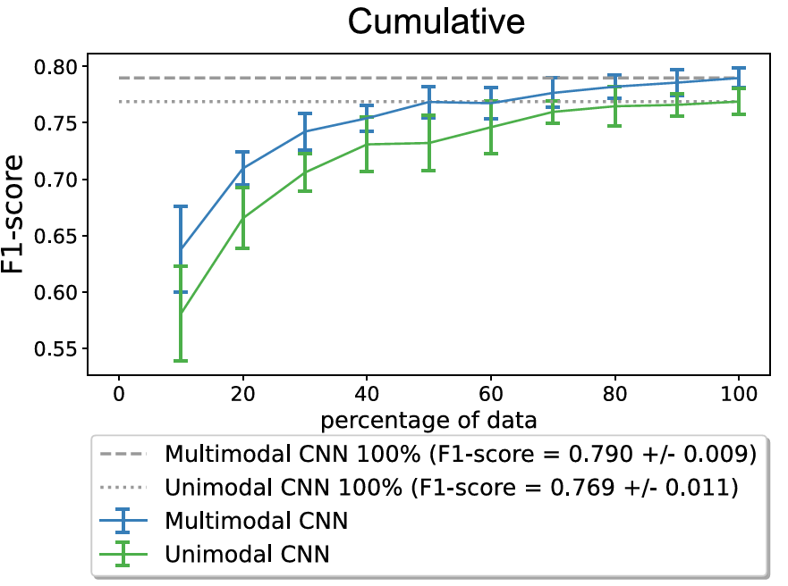
Results – WSI Classification
Multimodal representation outperforms unimodal representation
Higher F1-scpre with fewer
training samples

Slide 10
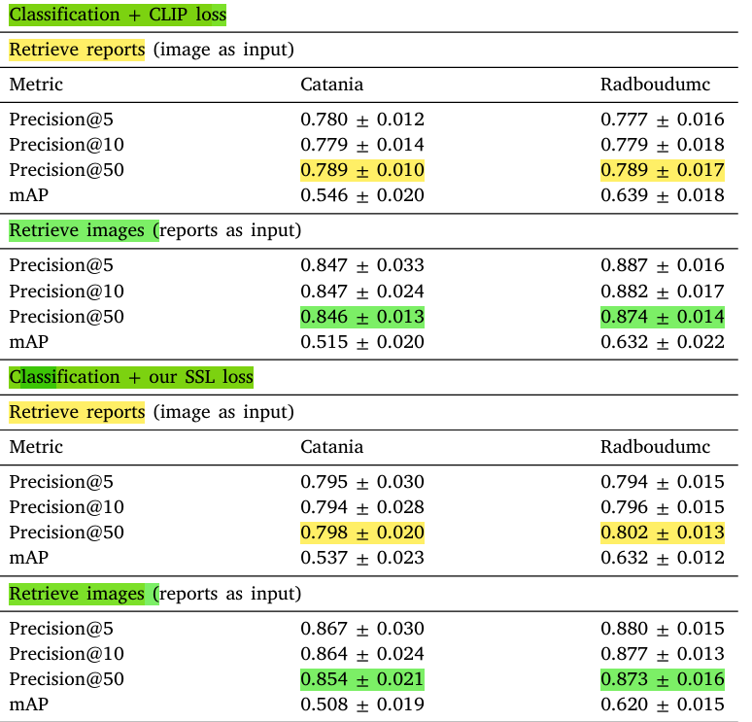
Results - Multimodal Data Retrieval
High precision@k and mAP
for image→text and text→image retrieval.
Retrieval system works without additional architectural design.

Slide 11
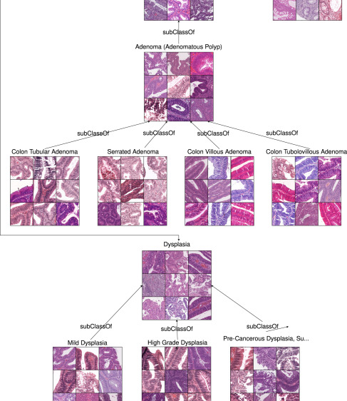
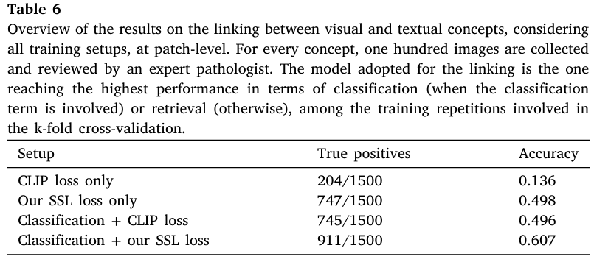
Results - Linking Visual and Textual Concepts
Linking between visual and textual concepts from the ExaMode ontology

Slide 12
Discussion & Critical Analysis (Strengths)
Data Efficiency
Achieves high performance with only 6,000 training samples (WSIs + reports).
Reduces reliance on large annotated datasets.
Multimodal Integration
Combines visual features (WSIs) + semantic context (reports).
Enables cross-modal retrieval and concept linking.
Loss Function Design
Composite loss (supervised + self-supervised) ensures robust alignment.
Components: NT-Xent (contrastive), L1 (magnitude), cosine (direction).

Slide 13
Discussion & Critical Analysis (Weaknesses)
Hyperparameter Sensitivity
Complex tuning of loss weights (NT-Xent, L1, cosine).
Time-consuming and less reproducible.
Scalability
Unclear performance on larger datasets with diverse stains/scanners.
Limited validation on non-colon pathologies.
Shared Projection Head
Simplified fusion may miss nuanced cross-modal interactions.
Text Augmentation
Struggles with domain-specific jargon and ambiguous phrasing.

Slide 14
Potential Improvements & Implementation
Adaptive Loss Weighting: Implement dynamic adjustment of loss weights to simplify hyperparameter tuning.
Dual-Projection Architecture: Experiment with separate projection heads for each modality followed by a fusion layer to capture more complex interactions.
Scaling and Domain Adaptation: Extend the framework to larger and more diverse datasets and incorporate domain adaptation techniques to improve generalization.
Enhanced Text Augmentation: Utilize state-of-the-art NLP models for paraphrasing and domain specific augmentation to better capture clinical language variability.

Slide 15
Thank You
https://doi.org/10.1016/j.media.2024.103303

